Slide 1

FINAL PROJECT
NAME:
GANNEM KRUPA VARSHINI

Slide 2
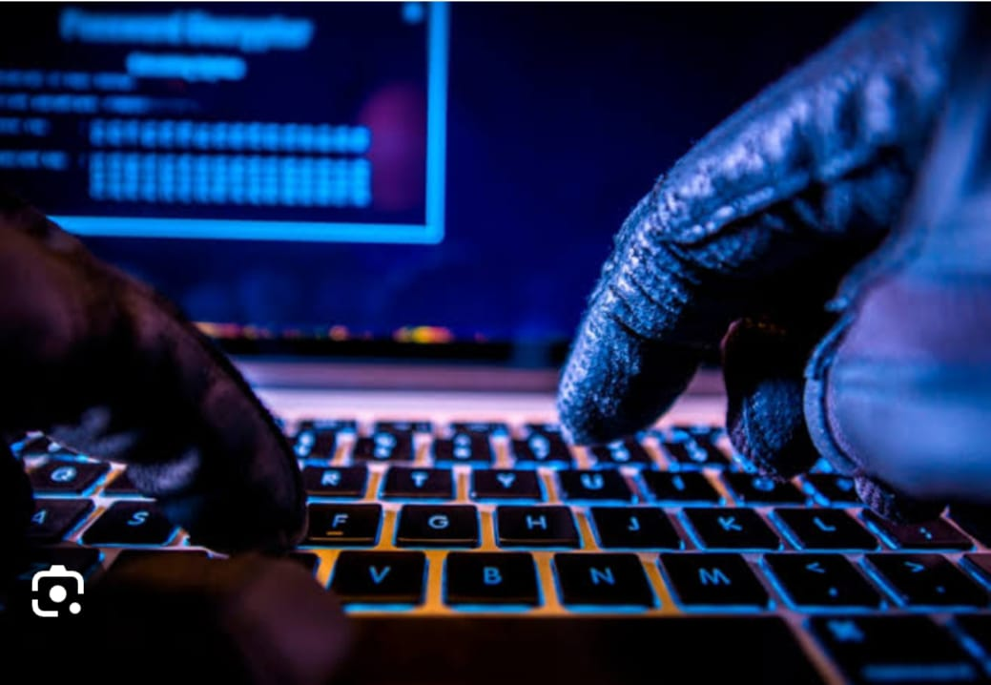
KEYLOGGER AND SECURITY
keylogger or keystroke logger /keyboard capturing is a form of malware or hardware that keeps track of and records your keystrokes as you type. It takes the information and sends it to a hacker using a command-and-control (C&C) serveA r

Slide 3

AGENDA
Introduction
Problem Statement
Project Overview
End Users
Solution & Value its Proposition
WOW in the solutions
Modelling
Results
Conclusion and Q&A

Slide 4


NITRODUCTION
keylogger, sometimes called a keystroke logger, is a type of surveillance technology used to monitor and record each keystroke on a specific device, such as a computer or smartphone. It can be either hardware- or software-based. The lattA er type is also known as system monitoring software or keyboard capture software.
Why are keyloggers used?
Keyloggers are often used as a spyware tool by cybercriminals to steal personally identifiable information, login credentials and sensitive enterprise data.
That said, some uses of keyloggers could be considered ethical or appropriate in varying degrees. For instance, keyloggers can also be used for the following reasons:
By employers to observe employees' computer activities.
By parents to supervise their children's internet usage.
By device owners to track possible unauthorized activity on their devices.
By law enforcement agencies to analyze incidents involving computer use

Slide 5


PROBLEM STATEMENT
A keylogger is a software or hardware tool that secretly records every keystroke made on a computer or mobile device.
tIs primary purpose is to monitor and capture the keys pressed on a keyboard, including letters, including letters, numbers, symbols, and special characters .
Keyloggers can be used for legitimate purposes (such as monitoring
employee productivity) or maliciously (for stealing sensitive information).
.

Slide 6


PROJECT OVERVIEW
Develop a comprehensive understanding of keyloggers, their type , how to work , and effective security measures to prevent keylogging attacks.
Scope:
Development Phase:
Design and implement a basic keylogger using programming languages and libraries.
Testing Phase:
Test the keylogger in a controlled environment to evaluate its functionality.
Analysis Phase:
Analyze the captured data to understand the keylogger’s effectiveness.

Slide 7


END USERS: Users are the individuals within an organization who regularly engage with digital platforms, applications, and devices . They play a crucial role as the first line of defense against cyber threats.
System Administrators: IT professionals responsible for managing and securing computing environments within an organization.
Organizations : Companies and institutions that need to ensure compliance with usage policies, enhance security, and monitor employee productivity.

Slide 8
SOLUTION AND ITS VALUE PROPOSITION
reation for Educational and Defensive Purposes:
Purpose: An ethical keylogger is designed to be used as a tool for educational and defensive cybersecurity purposes.
Educational Use:
Demonstrates how keyloggers operate, providing insights into their mechanisms and behaviors.
Defensive Use:
Assists in developing robust security measures by understanding potential vulnerabilities exploited by malicious keyloggers.
Defensive Strategies:
Building Resilience:
Helps in creating more resilient security systems by knowing the tactics and techniques used by attackers.
Enhanced Detection:
Contributes to the development of advanced detection tools and methods to identify and neutralize keyloggers.

Slide 9

WOW IN OUR SOLUTION
Steps for process of keylogger and security
User input Device keyloggers)
6.Attacher’s Server.
(keyboard)
2.Keylogger (software/Hardware)
3.Data capture Module
4. Data Storage Module
5.Data Transmission module (for remote keyloggers
6.Attacher’s Server.
Store Locally (local file)
tTransmit to Remote Server
Continue Capturing Keystrokes
stop

Slide 10
MODELLING
Installing Required Libraries :
Before we begin, we need to install a particular library, which we can do with the pip command: pip install pynput and pip install jsonlib.
Importing Required Libraries
pynput: This will help us read the keystrokes as the user types in stuff
JSON is a lightweight data-interchange format. It is often used for exchanging data between a web server and user agent

Slide 11

Initialization: Set up the main GUI window. Initialize global variables for key logging. Event Capture: Start capturing key events when the "Start" button is pressed. Log key press and release events. Data Logging: Continuously update text and JSON log files with captured key events. Stop Logging: Stop capturing key events when the "Stop" button is pressed. Update the GUI status to indicate the keylogger is stopped.

Slide 12
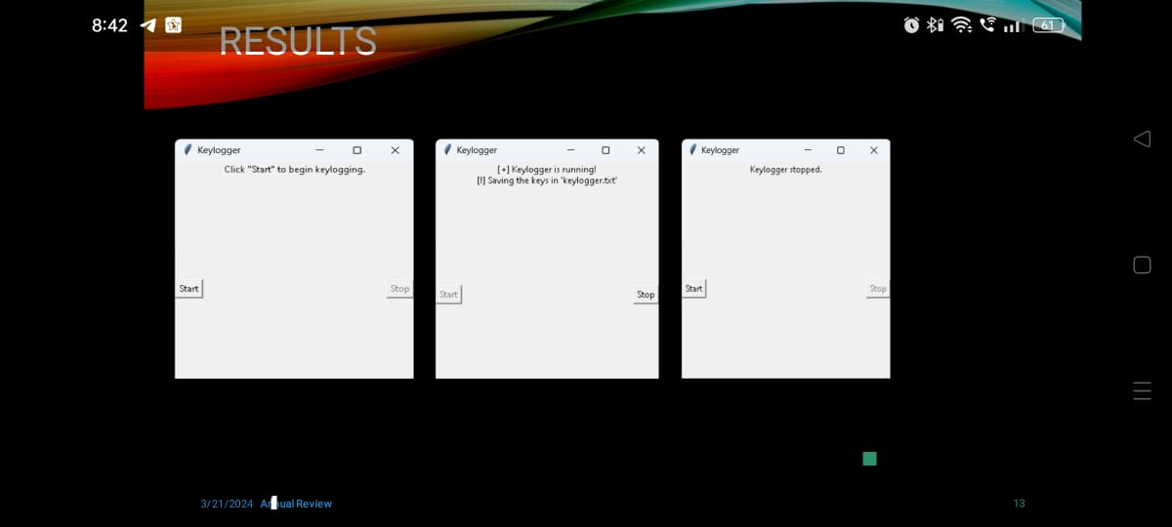
RESUIT
INTELLIGENT LIFE
INTELLIGENT LIFE
ELLIGENT LIFE

Slide 13
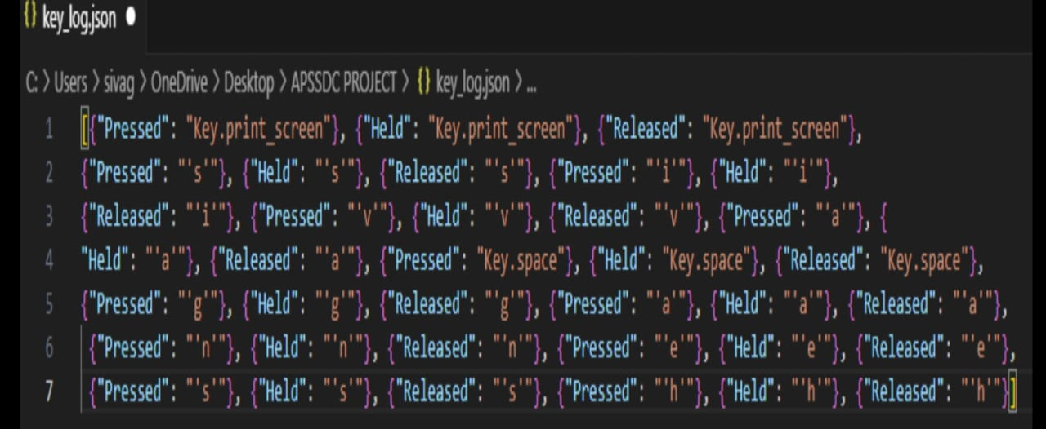

Slide 14
THANK YOU
.

